Slide 1
Computer Graphics (L05)
EG678EX
2-D Algorithms

Slide 2
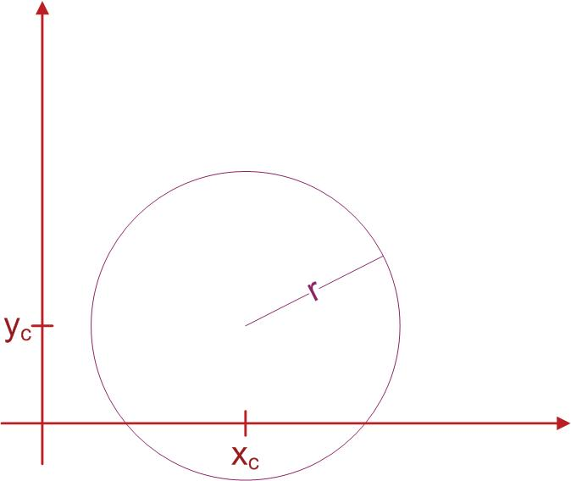
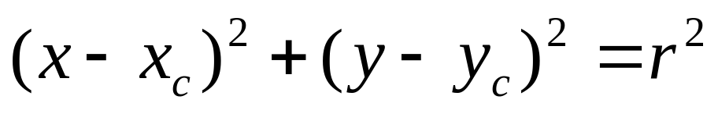
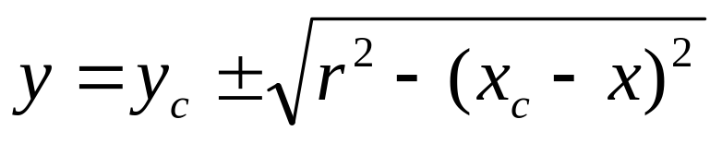
Circle-Generating Algorithms (Basic Foundations)
Circle Equation:
Points along circumference could be calculated by stepping along x-axis:
Problem ????

Slide 3
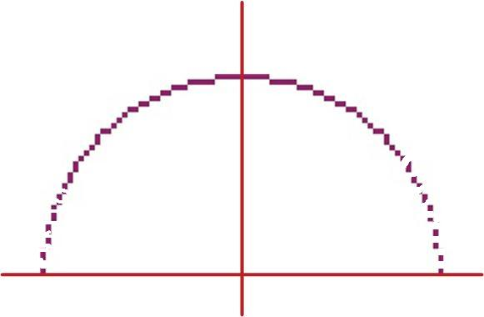
Problem (in above method)
Computational complexity
Spacing:
  Non-uniform spacing of plotted pixels

Slide 4
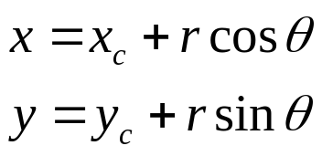
Adjustments (To fix problems)
Spacing problem (2 ways):
  Interchange the role of x and y whenever the absolute value of the slope of the circle tangent > 1
  Use polar co-ordinate:
    Equally spaced points are plotted along the circumference with fixed angular step size.
    step size chosen for θ depends on the application and display device.
      For more continuous boundary on a raster display, set step size at 1/r; i.e pixel positions are approximately 1 unit apart.
Computation Problem:
  Use symmetry of circle; i.e calculate for one octant and use symmetry for others.

Slide 5
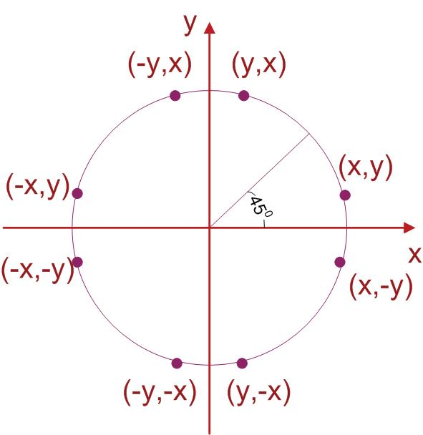
Circle Symmetry

Slide 6
Bresenham’s Algorithm Could Be Adapted ??
Yes
How ?
  Setting decision parameter for finding the closest pixel to the circumference
And what to do For Non-linear equation of circle ?
  Comparison of squares of the pixel separation distance avoids square root calculations

